Slide 1
Department of CSE H COURSE NAME: PSQT
COURSE CODE: 22mt2005
Topic:
Discrete Probability Distributions
Bernoulli, Binomial Distributions
and their Applications

Slide 2



AIM OF THE SESSION
To familiarize the students with the concepts of Discrete Probability like Bernoulli, Binomial Distributions and their Applications
INSTRUCTIONAL OBJECTIVES
This Session is designed to explain
1. Demonstrate the Bernoulli trial with suitable examples
2. List out the rules of Bernoulli and Binomial distributions
3. Solving the problems of Binomial distribution
4. Discuss he importance of Binomial distribution and its applications in real world problems
LEARNING OUTCOMES
At the end of this session, the you will be able to
1. Define Discrete Probability and Bernoulli trial
2. Describe the rules of discrete probability distributions
3. Summarize the concepts of Binomial distribution and its applications

Slide 3
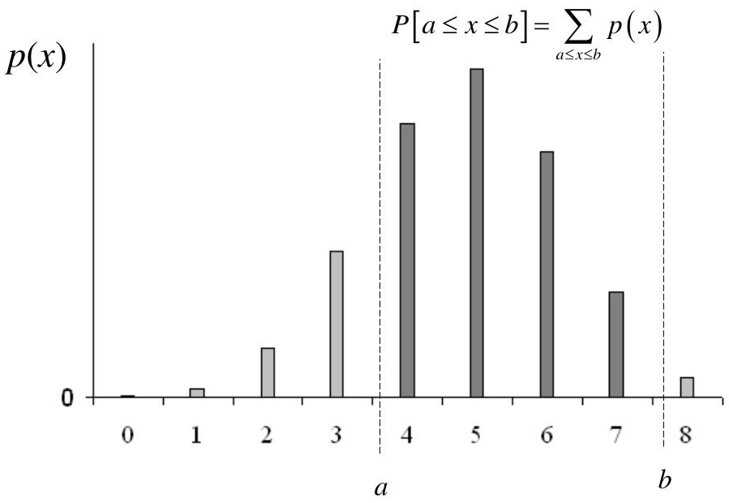
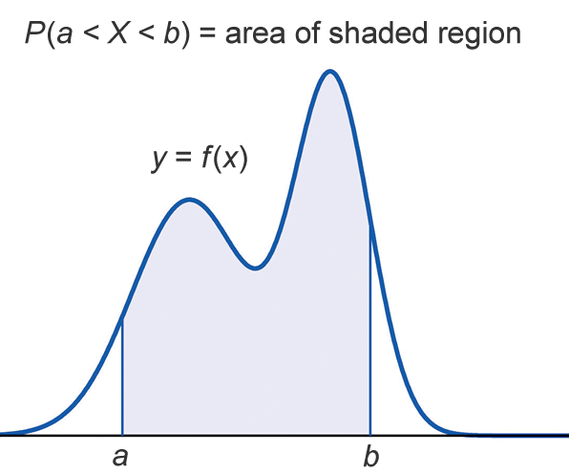
SESSION INTRODUCTION
A random variable is a variable that takes on different values determined by chance. In other words, it is a numerical quantity that varies at random.
A random variable X is a function from the sample space S to the real numbers ℜ.
X : S → ℜ Types of Random Variables
There are mainly two types of random variables:
Discrete Random Variable: When the random variable can assume
only a countable and sometimes an infinite, number of values.
Continuous Random Variable: When the random variable can assume
an uncountable number of values in a line interval.
Probability Function: A probability function is a mathematical function
that provides probabilities for the possible outcomes of the
random variable, it is typically denoted as f(x).

Slide 4
EXAMPLES
SESSION INTRODUCTION
Discrete Random Variables
Number of Scratches on a Surface
Number of Defective Parts among 1000 tested
Continuous Random Variables
Electrical Current
Length
Number of Transmitted Bits Received Error
Time
Temperature
Weight

Slide 5
SESSION INTRODUCTION
(Probability Mass Function/discrete density function)
Discrete Random Variable: When the random variable can assume only a countable and sometimes an infinite, number of values.
Probability Mass Function: A probability function is a mathematical function that provides probabilities for the possible outcomes of the random variable, it is typically denoted as f(x). Sometimes it is also known as the discrete density function.
Consider a random experiment of tossing two fair coins.
The sample space is S = {TT, HT, TH, HH}
Let X denote the number of heads observed.
X(TT) = 0, X(HT) = 1, X(TH) = 1, X(HH) = 2
So, the random variable X can take 3 distinct values: 0, 1, 2.
Let us compute the probability of these 3 values of X using relative frequency approach by assuming that all 4 outcomes of the sample space are equally likely.
Then, p(0) = P(X=0) = ¼ p(1) = P(X=1) = 2/4 = ½ p(2) = P(X=2) = ¼
Such a listing of probabilities of all possible values a discrete random variable can take is called the Probability Mass Function or discrete density function of X.

Slide 6


Probability Mass Function
Definition:
Let x1, x2, x3, … be the possible values a discrete random variable X can take.
The function
is called the probability mass function (PMF) of X.
In other words, the probability mass function (PMF) of a discrete random variable X assigns probabilities to the possible values of the random variable.
Properties of PMF:
The cumulative distribution function (CDF) of a discrete random variable X can be computed in terms of PMF of X as follows:
PX(xk)=P(X=xk),for k=1,2,3,…,

Slide 7
Bernoulli Random Variable/
Bernoulli Trial
A Bernoulli random variable/Bernoulli Trial is a random variable that can only take two possible values, usually 0 and 1. This random variable, models random experiments that have two possible outcomes, sometimes referred to as "success" and "failure“.
The name is due to the Swiss mathematician Jacob Bernoulli.
Some examples:
You take a pass-fail exam. You either pass (resulting in X=1) or fail (resulting in X=0).
The outcome of flipping a coin is either H or T.
A child is born. The gender is either male or female.
If probability of "success" is p, the probability of "failure" is 1-p = q.
Values of a Bernoulli Trial
1 | 0
Success | Failure
H | T

Slide 8
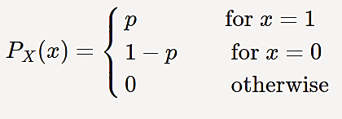
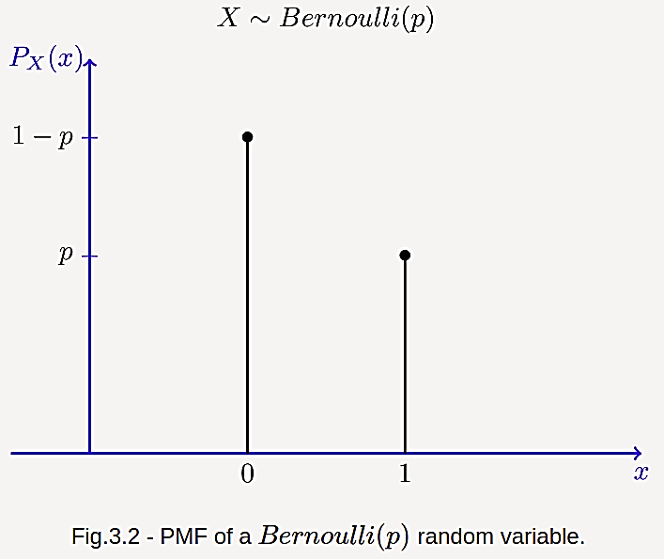

Expectation and Variance of
Bernoulli Random Variables
Properties of Expectation and Variance
Definition: A random variable X is said to be a Bernoulli random variable with parameter p, shown as X∼Bernoulli(p), if its PMF is given by
Bernoulli Distribution Graph
where 0 < p < 1.
Expectation: Let X∼Bernoulli(p), possible pdf is given below.
Find E[X].
For the Bernoulli distribution, the range of X is = {0,1}.
P(0) = 1-p and P(1) = p
E[X] =
E[X] = 0. (1-p) + 1. p == p

Slide 9
Applications of Bernoulli Distribution
Bernoulli distribution is a simple distribution and hence, is widely used in many industries.
Given below are some applications of Bernoulli distribution.
In medicine, Bernoulli distributions are used to model the events experienced by a single patient. These events could be disease, death, and so on.
Logistic regressions use Bernoulli distribution to model the occurrence of certain events such as the specific outcome of a dice roll.
Bernoulli distribution is also used as a basis to derive several other probability distributions that have applications in the engineering, aerospace, and medical industries.

Slide 10
Properties of Bernoulli Distribution
Bernoulli distribution is a discrete probability distribution where the Bernoulli random variable can have only 0 or 1 as the outcome.
Let p is the probability of success and 1 - p is the probability of failure.
The mean of a Bernoulli distribution is
E[X] = p
and the variance, Var[X] = p(1-p) = pq
Bernoulli distribution is a special case of binomial distribution when only 1 trial is conducted.

Slide 11
Example-5.1a
A basketball player can shoot a ball into the basket with a probability of 0.6. What is the probability that he/she misses the shot?
Solution: We know that success probability P (X = 1) = p = 0.6
Thus, probability of failure is P (X = 0) = 1 - p = 1 - 0.6 = 0.4
So, the probability of failure of the Bernoulli distribution is 0.4

Slide 12
Example-5.1b,c
Example-5.1b:
If a Bernoulli distribution has a parameter 0.45 then find its mean.
Solution: X ∼ Bernoulli (p) or X∼ Bernoulli (0.45).
Mean E[X] = p = 0.45
Example 5.1c:
If a Bernoulli distribution has a parameter 0.72, then find its variance.
Solution: X∼ Bernoulli (p) or X∼ Bernoulli (0.72).
Variance Var[X] = p (1-p) = 0.72 (0.28) = 0.2016

Slide 13
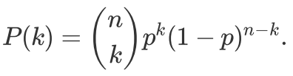

Binomial Distribution
A binomial random variable is random variable that represents the number of successes in n successive independent trials of a Bernoulli experiment.
If X is a Binomial random variable, we denote this X ∼ Binomial (n, p), where p is the probability of success in a given trial.
The binomial distribution formula is for any random,
For n independent Bernoulli trials where each trial has success probability p, the probability of k successes is given by
Binomial theorem:

Slide 14

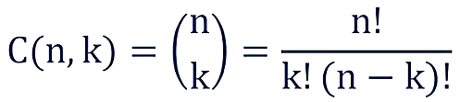
Binomial Random Variable
Suppose that I have a coin with P(H)=p. I toss the coin n times and define X to be the total number of heads that I observe. Then X is binomial with parameters n and p.
We write X∼Binomial(n,p).
The range of X in this case is R_{X}={0,1,2,...,n}.
For example, Let n=5, and let us compute the probability of getting exactly 4 heads, P (X = 4). The probability of one sample sequence (HTHHH) is given by
P(HTHHH) = p.(1-p).p.p.p = p⁴(1-p)⁵⁻⁴
There are C(5,4) such sequences of coin flips that give exactly 4 heads. So, we need to add the probability of C(5,4) cases.
So, we get
We can generalize this to get the PMF of a binomial random variable.
Note:

Slide 15

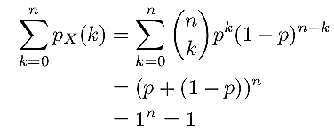
Binomial Distribution
Definition: A random variable X is said to be a binomial random variable with parameters n and p, shown as X∼Binomial(n,p), if its PMF is given by
where 0 < p < 1.
Since PX(k) is a PMF, the sum of all probabilities should add upto 1.

Slide 16
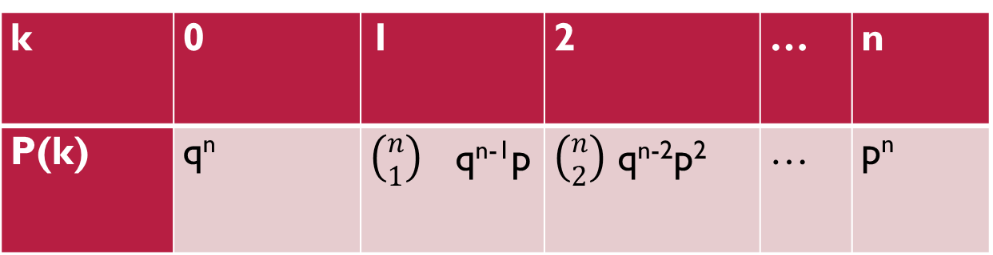
Binomial Distribution Properties
Note: If we regard n and p as constant, then the above function P(k) = Binomial (k; n, p) is a discrete probability distribution:
where 0 < p < 1.
k | 0 | 1 | 2 | … | n
P(k) | q^{n} | $\left({n \atop 1}\right)$ q^{n-1}p | $\left({n \atop 2}\right)$ q^{n-2}p² | … | p^{n}

Slide 17
Binomial Distribution Applications
Banks and other financial institutions use to determine the likelihood of borrowers defaulting, and apply the number towards pricing insurance, and figuring out how much money to keep in reserve, or how much to loan.
Medical professionals use to model the probability that a certain number of patients will experience side effects as a result of taking new medications.
Banks use to model the probability that a certain number of credit card transactions are fraudulent.
Mail companies use to model the probability that a certain number of spam emails land in an inbox per day.
Park systems use to model the probability that rivers overflow a certain number of times each year due to excessive rain.
Retail stores use to model the probability that they receive a certain number of shopping returns each week.

Slide 18

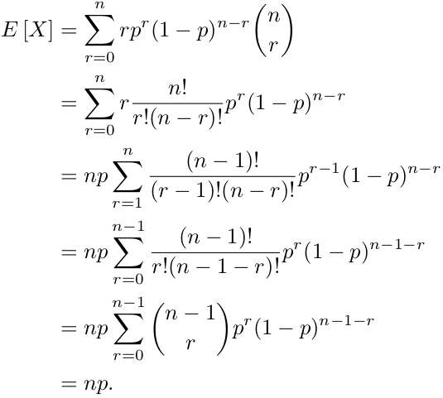
Binomial Random Variable
Expectation: Binomial rv (Random Variable)
Let X∼Binomial(n,p), if its PMF is
E(X) = Σxp(x)
Here x=r.

Slide 19
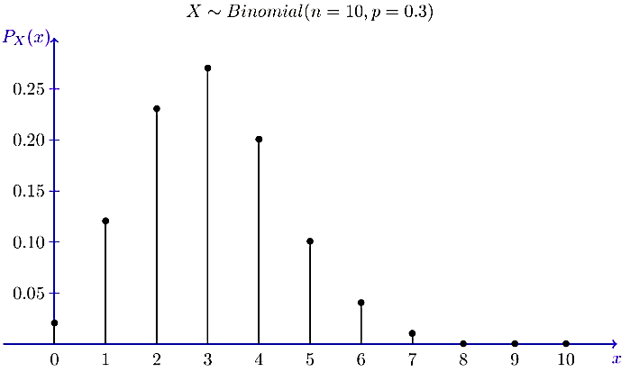
Binomial Random Variable
Expectation

Slide 20
Examples
A fair die is tossed 180 times. Find the expected number of sixes and the standard deviation.
Solution:
The expected number of sixes is μ = np = 180.1/6 = 30
Standard Deviation σ = √npq = √180.1/6.5/6 = 5
2. A fair coin is tossed 6 times or equivalently, six fair coins are tossed; call heads a success.
The probability that exactly two heads occur
The probability of getting at least 4 heads
The probability of n heads (all fails)
Solution:
Here n=6, p=q=1/2
(i) The probability that exactly two heads occur (k=2) is
Binomial(2;6,1/2)=C(6,2) (½)2(1/2)4=15/64
(ii) The probability of getting at least 4 heads (k=4,5,or 6) is
Binomial (4;6,1/2) + Binomial (5;6,1/2) + Binomial (6;6,1/2) =11/32
(iii) The probability of n heads (all fails) is q⁶=(1/2)⁶ = 1/64
So, the probability of at least one head is 1- q⁶=23/24

Slide 21
Examples
Example 1: If a coin is tossed 5 times, using binomial distribution find the probability of:
(a) Exactly 2 heads (b) At least 4 heads.
Solution:
(a) The repeated tossing of the coin is an example of a Bernoulli trial. According to the problem:
Number of trials: n=5
Probability of head: p= 1/2 and hence the probability of tail, q =1/2
For exactly two heads: x=2
P(x=2) = ⁵C₂ p² q⁵⁻² = 5! / 2! 3! × (½)²× (½)³ = 5/16
(b) For at least four heads,
x ≥ 4, P(x ≥ 4) = P(x = 4) + P(x=5)
Hence, P(x = 4) = ⁵C₄ p⁴ q⁵⁻⁴ = 5!/4! 1! × (½)⁴× (½)¹ = 5/32
P(x = 5) = ⁵C₅ p⁵ q⁵⁻⁵ = (½)⁵ = 1/32
Answer: Therefore, P(x ≥ 4) = 5/32 + 1/32 = 6/32 = 3/16

Slide 22

Examples
3.A fair die is tossed 7 times;call a toss success if a 5 or a 6 appears.Then n=7,p=P({5,6})=1/3 and q=1-p=2/3.
(i)The probabililty that a 5 or a 6 occurs exactly 3 times(i.e.k=3) is b(3,7,1/3)=$\left(\begin{aligned}7 \\ 3\end{aligned}\right)(1/3)$³(2/3)⁴=560/2187
(ii)The probability that a 5 or 6 never occurs (i.e.all failures)is
q⁷=(2/3)⁷=128/2187;hence the probability that a 5 or 6 occurs at least once is 1-q⁷=2059/2187.

Slide 23
SUMMARY
Bernoulli Distribution | Binomial Distribution
Bernoulli distribution is used when we want to model the outcome of a single trial of an event. | If we want to model the outcome of multiple trials of an event, Binomial distribution is used.
It is represented as X ∼ Bernoulli (p). Here, p is the probability of success. | It is denoted as X ∼ Binomial (n, p). Where n is the number of trials.
Mean, E[X] = p | Mean, E[X] = np
Variance, Var[X] = p(1-p) = pq | Variance, Var[X] = np(1-p) = npq (Mean is always greater than variqance.)
Example: Suppose the probability of passing an exam is 80% and failing is 20%. Then the Bernoulli distribution can be used to model the passing or failing in such an exam. | Example: Suppose the probability of passing an exam is 80% and failing is 20%. Then if we want to find the probability that a student will pass in exactly 4 out of 5 exams, we use the Binomial Distribution.

Slide 24
SELF-ASSESSMENT QUESTIONS
Bernoulli trials only deal with mutually exclusive outcomes.
True
False
How many outcomes can a Bernoulli trial have?
3
2
5
2^{n}

Slide 25
SELF-ASSESSMENT QUESTIONS
3. What is the formula for binomial distribution?
a) P [X = x] = ^{n}C_{n} p^{x} q^{n-x} b) P [X = x] = ^{x}C_{x} p^{x} q^{n-x} c) P [X = x] = ^{n}C_{x} p^{x} q^{n-x} d) P [X = x] = ^{n}C_{x} p^{n} q^{n-x}
4. The mean and variance of a random variable having binomial probability distribution are 4 and 2 respectively, then P(X = 1) is:
1/32
1/16
1/8
1/4

Slide 26
TERMINAL QUESTIONS
1. Explain the Expectation, variance and standard deviation of Bernoulli and Binomial Distributions.
2. List out formulas for Bernoulli and Binomial Distributions.
3. Five cards are drawn successively with replacement from well - shuffled deck of 52 cards.
a) The probability that all the five cards are spades is 1/1024
b) The probability that only 3 cards are spades is 45/512
Verify the statements (a) and (b).
4. Summarize the use of Bernoulli and Binomial Distributions in Realtime applications.

Slide 27
REFERENCES FOR FURTHER LEARNING OF THE SESSION
Reference Books:
1. William Feller, An Introduction to Probability Theory and Its Applications: Volume 1, Third Edition, 1968 [CH6] [Page No.147-149]
2. Alex Tsun, Probability & Statistics with Applications to Computing [CH3] [Page No.74-83]
3. Murray R Spiegel, J Schiller, R A Srinivasan, Schaum's Outlines of Probability and Statistics 4e[Page No. 75]
Sites and Web links:
1. https://vdocument.in/means-and-variances-of-random-variables-56e7f9ee33dd4.html?page=12
2. https://mathsci.kaist.ac.kr/~nipl/cc511/lectures/
3. https://www.wyzant.com/resources/lessons/math/statistics_and_probability/expected_value/
4. http://www.statslab.cam.ac.uk/~rrw1/prob/prob-weber.pdf

Slide 28
THANK YOU
Team – PSQT EVEN SEM 2023-2024

